Slide 1

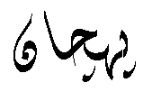
URDU OCR - offline
PEHCHAN
T h e R e c o g n i t i o n

Slide 2
PROJECT TEAM:
Muhammad Umair Anjum | BCS03-07R
Zill-e-Subhan | BCS03-35R
Imran Ali | BCS03-05R
Muhammad Kamran | BCS03-02R
SUPERVISED BY:
Mr. Fahad Maqbool
Lecturer Department of CS & IT, University of Sargodha.

Slide 3

Project Overview

Slide 4

“Pehchan” is an offline Urdu OCR.
Objective is to convert the scanned Urdu image into editable document. Particularly designed for the font ‘Noori Nastaliq’.
Techniques of Digital Image Processing and Neural Networks are used.
Have a variety of applications in both government and private sector, e.g. Police records, land records, newspapers etc.

Slide 5
Road Map
Image Acquisition
Grey Scale Removal
Noise Removal
Lines Segmentation
Ligatures Segmentation
Ligatures Thinning

Slide 6
Image Acquisition

Slide 7
Objective
To acquire the image so that processing could be performed on it.
Our Approach
Offline images are used. Image can be in database or at any location of hard disk.
Image should be in “.jpg” or ”.bmp” format.

Slide 8
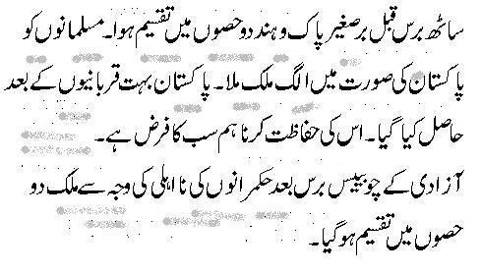
Sample Image

Slide 9

Grey Scale Removal

Slide 10
Objective
To remove the Grey Scale so that it is easy to remove noise from image
Our Approach
We perform Grey Scale Removal by using threshold value comparison.

Slide 11
Algorithm (Grey Scale Removal)
For x=0 to width of image
For y=0 to height of image
If color of pixel(x,y) < threshold than
setpixel(x,y) to white
Move forward

Slide 12
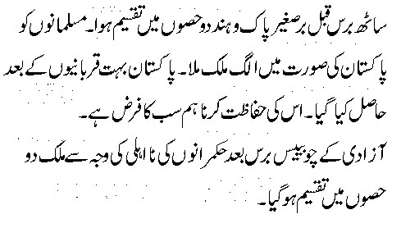
Before Grey Scale
Removal
After Grey Scale
Removal

Slide 13
How ???

Slide 14
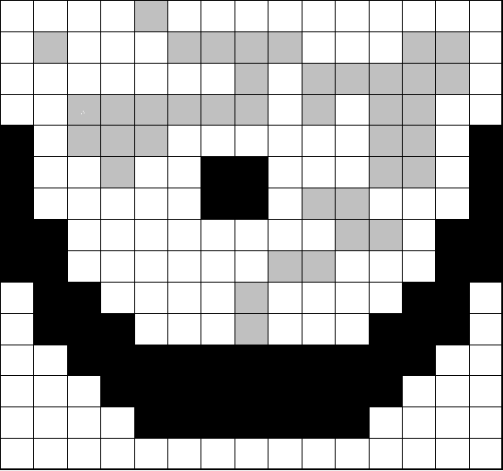
Pixel value<TH
Pixel value>=TH

Slide 15

If pixel value<TH then set pixel =white

Slide 16
Noise Removal

Slide 17
Algorithm (Unwanted Dots Removal)
For x=0 to width of image
For y=0 to height of image
If pixel(x,y) is black and has no black neighbors than delete pixel(x,y)
Move forward

Slide 18
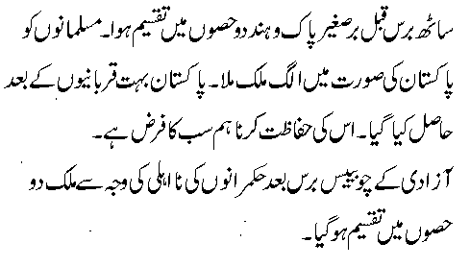
Image with Noise
Noise Removed

Slide 19
How ???

Slide 20
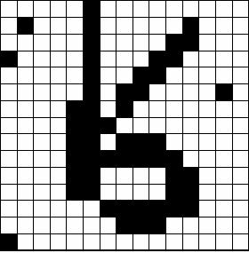
Black Pixel without
Any black neighbors so remove it
Black Pixel with black neighbor so don’t remove
Extra Dots
Removed
Y-axis
X- axis

Slide 21
Line Segmentation

Slide 22
Objective
To recognize the lines of text from the scanned image
Our Approach
We use ‘horizontal histogram’ for this purpose

Slide 23
Algorithm (Line Segmentation)
1-Generate horizontal histogram of the image based on black pixel count of each row.
2-Calculate mean of histogram
3-Traverse the histogram in line by line fashion.
4-Mark Pt1 at the first line encounter that is greater than mean.
Move forward
5-Mark Pt2 at the first line encounter after pt1 that is less than mean.
(The text line is between pt1 and pt2)
6-Continue for remaining histogram

Slide 24
Lines Segmented

Slide 25
How ???

Slide 26

Lines Segmented
Height of Line
Horizontal Histogram
pt1
pt2
Width of Line

Slide 27
Ligatures Segmentation

Slide 28
“Ligature is a set of connected pixels in Urdu Language”
Objective:
To recognize ligatures from lines of text image.
Our Approach:
We segment ligatures by masking with recursion.

Slide 29


+
+
+
Lig-1
Lig-2
Lig-3
Lig-4

Slide 30
How ???

Slide 31

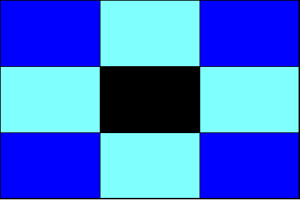
P(x,mid)

Slide 32
Min (y)
Max (x)
Min (x)
Max (y)

Slide 33
Ligatures Thinning

Slide 34
Objective:
To convert ligatures into single pixel lines or edges.
Our Approach:
We use Heildich approach to thin our ligatures.

Slide 35
How ???

Slide 36


Slide 37
Future Work……
Character Segmentation.
Character Recognition.

Slide 38
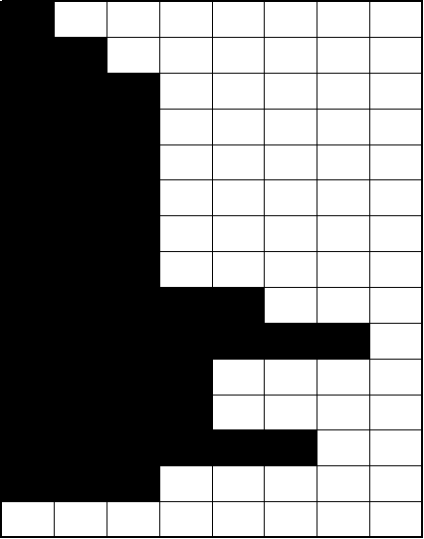
2 black pixels
2-pixels long histogram
Image
Horizontal Histogram

Slide 39

THANKS

